Slide 1
PROCESS MANAGEMENT

Slide 2
PROCESS
A process is a running instance of a launched executable program.
Every new process is assigned a unique process id(PID) for tracking & security.
Every Process have a parent process have a id called PPID.
All Process are descendent of first of the first system process systemd or init in linux.

Slide 3
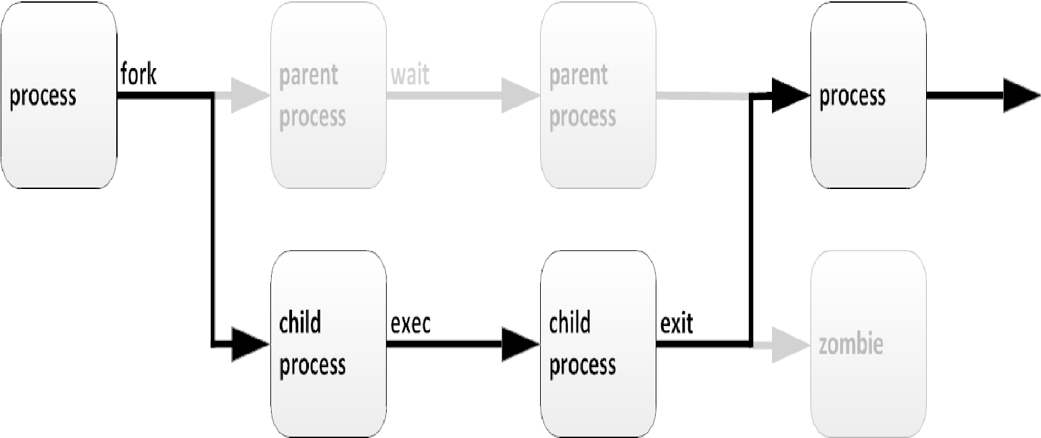
PROCESS UNDERSTANDING

Slide 4
PROCESS STATE
Running
Sleeping
Stopped
Zombie

Slide 5
PROCESS LIST COMMANDS
Ps
Ps -A
ps aux
ps –ef
Ps –fU username

Slide 6
JOB & SESSION
Job control is a feature of the shell which allows a single shell instance to run and manage multiple commands.
Each terminal is its own session, and can have a foreground process and any number of independent background processes.
Jobs
Fg %x
Ctrl + Z
Bg %x

Slide 7
KILL PROCESS SIGNAL(KILL –L)
Signal number | Short name | definition | purpose
1 | HUP | Hangup | Reload configuration
2 | INT | Keyboard interrupt | CTRL+C
3 | QUIT | Keyboard quit | CTRL+\
9 | KILL | Kill,Unblockable | Forcefully terminate
15(default) | TERM | Terminate | Polite way to terminate
18 | CONT | Continue | resume
20 | TSTP | Keyboard stop | CTRL+Z

Slide 8
PKILL COMMAND
Use pkill to send a signal to one or more processes which match selection criteria. Selection criteria can be a command name, a processes owned by a specific user, or all system-wide processes like:
Pkill –U user
Pkill –t tty3
Pkill –P process_id

Slide 9
MONITORING SYSTEM
Uptime command
Top command

Slide 10
PROCESS PRIORITY
Each process is assigned a process priority to determine how much CPU or processor time is allocated to it for execution.
The process priority determines which process gets more CPU time and which processes can be left to wait in the background.
The nice value of a process can have a range between -20 (highest priority) to +19 (lowest priority)
By default, the nice value is zero

Slide 11
MODIFY PROCESS PRIORITY
Nice –n -10 firefox
Renice –n 10 –p 1234
Renice –n 5 –u sam

